Slide 1

Gold Price Prediction
Project Supervisor: Dr. T. Prem Jacob Ph.D
Name of the Student: P.Dheeraj
Register Number: 40110319

Slide 2
Presentation Outline
Introduction & Aim
Objectives & Scope
System Requirements/System Architecture
Flow Chart
Project Implementation
Application snapshots
Methodology
Results and Discussions
Conclusion & Future work
References

Slide 3
Introduction
Gold is one of the precious metals. It has been used as currency, for jewelry and other purposes. It is used as medium for money or exchange because of its limited supply and high value
. It also reflects the country’s economic strength and hence many companies and individuals started to invest in gold reserves. Due to its increasing value, many people considered gold as an attractive investment.
AIM:
In this project, we shall analyze and predict the upcoming prices of Gold, using Machine Learning’s Random Forest Regressor algorithm

Slide 4
Objectives and Scope
The Project titled 'GOLD PRICE PREDICTION' predicts the gold's price based on:
Date — mm/dd/yyyy
SPX — is a free-float weighted measurement stock market index of the 500 largest companies listed on stock exchanges in the United States.
GLD — Gold Price
USO — United States Oil Fund
SLV — Silver Price
EUR/USD — currency pair quotation of the Euro against the US

Slide 5
1.This project is based on the applicability of the proposed machine learning algorithms that had demonstrated their efficiency to predict gold prices with a better predictive rate.
2. To apply the best appropriate Machine Learning procedure.
3. We proposed the development of a prediction model for predicting future gold prices using Random forest regressor

Slide 6
System Requirements
Software Requirements
ANY Operating System (Windows 10 / 8, Linux, Mac)
Jupyter Notebook
Anaconda
Python 3.8
HARDWARE REQUIREMENT
→Operating System : Laptop Intel i3 3rd Gen clock speed 2.5 GHz & above
→Hard disk : min. 10 GB
→Ram : 1 GB or above Monitor
→ resolution : 800 X 600

Slide 7
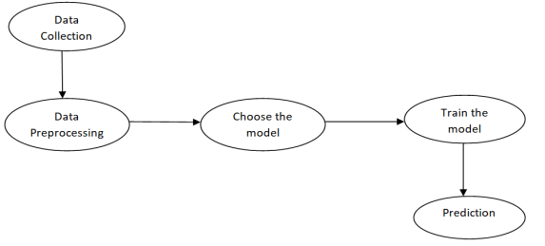
How do we predict gold prices?

Slide 8
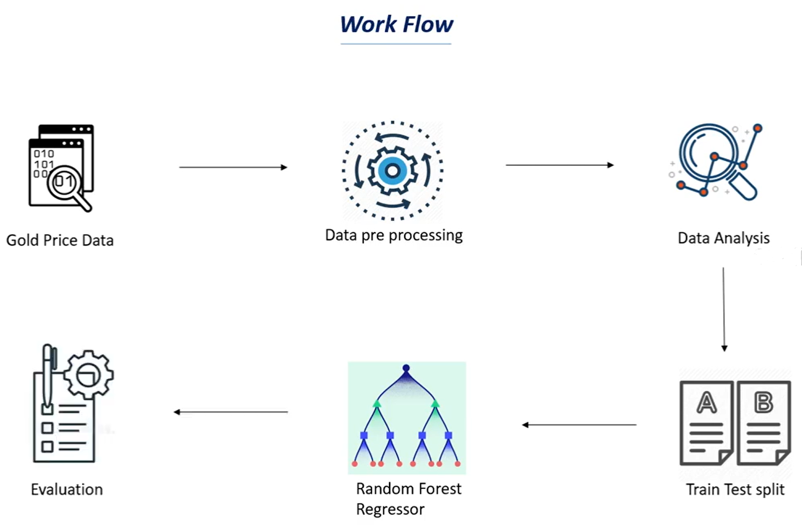
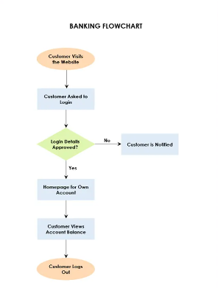
System Architecture

Slide 9
Project Implementation
gold prices are provided by several data feed providers, in the event that there is a failure in one data feed provider we switch to one of our other providers.
Gold prices are sometimes referred to as world gold prices, New York gold prices, spot gold prices, gold market prices and gold bullion prices. These prices are indications of the current trading prices for one troy ounce of gold on the various world exchanges
This price is quoted in US dollars. Where the gold price is displayed in currencies other than the US dollar, it is converted into the local currency.
Like all prices, the gold price reflects not only the inherent value of gold, but also the relative strength of the currency in which it is quoted. For example, the dollar price of gold may increase more in percentage terms than the Euro price of gold, to the extent that the change in price is a reflection of dollar weakness (in this case, against Euros) rather than an intrinsic change in gold market fundamentals.

Slide 10
Data preprocessing
Data preprocessing is required when the data is incomplete, inconsistent or noisy. The data collected was noisy, so we performed outlier analysis and removed the noisy data. The data transformation is also done by performing normalization in which the data in each attribute is scaled between the range 0 to 1.
Train test split
Split the data into target values and feature values :
X = gold_data.drop(['Date','GLD'],axis=1) Y = gold_data['GLD']
As there were no empty cells, we could readily begin with the table manipulations;
Here, X is the feature variable, containing all the features like SPX, USO, SLV, etc., on which the price of gold depends, excluding the GLD and Date column itself.
Y, on the other hand, is the target variable, as that is the result that we want to determine,i.e, the price of Gold. (It contains only the GLD column)

Slide 11
Random forest regression
Random Forest is a popular machine learning algorithm that belongs to the supervised learning technique. It can be used for both Classification and Regression problems in ML. It is based on the concept of ensemble learning, which is a process of combining multiple classifiers to solve a complex problem and to improve the performance of the model.
As the name suggests, "Random Forest is a classifier that contains a number of decision trees on various subsets of the given dataset and takes the average to improve the predictive accuracy of that dataset." Instead of relying on one decision tree, the random forest takes the prediction from each tree and based on the majority votes of predictions, and it predicts the final output.
The greater number of trees in the forest leads to higher accuracy and prevents the problem of overfitting.

Slide 12

The working of the algorithm can be better understood by the below example:Suppose there is a dataset that contains multiple fruit images. So, this dataset is given to the Random forest classifier. The dataset is divided into subsets and given to each decision tree. During the training phase, each decision tree produces a prediction result, and when a new data point occurs, then based on the majority of results, the Random Forest classifier predicts the final decision

Slide 13
How does Random Forest algorithm work?
Random Forest works in two-phase first is to create the random forest by combining N decision tree, and second is to make predictions for each tree created in the first phase.
The Working process can be explained in the below steps and diagram:
Step-1: Select random K data points from the training set.
Step-2: Build the decision trees associated with the selected data points (Subsets).
Step-3: Choose the number N for decision trees that you want to build.
Step-4: Repeat Step 1 & 2.
Step-5: For new data points, find the predictions of each decision tree, and assign the new data points to the category that wins the majority votes.

Slide 14
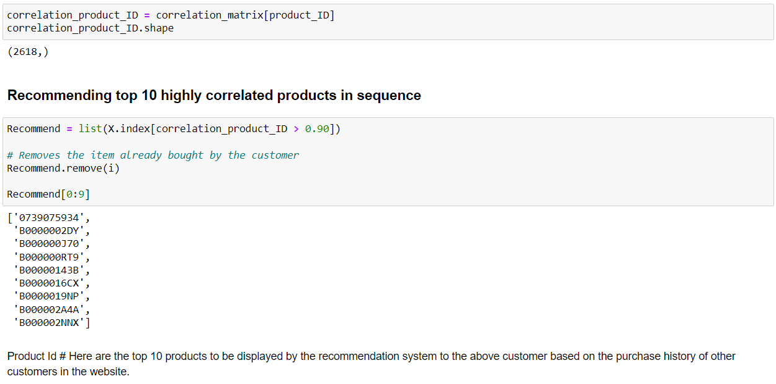
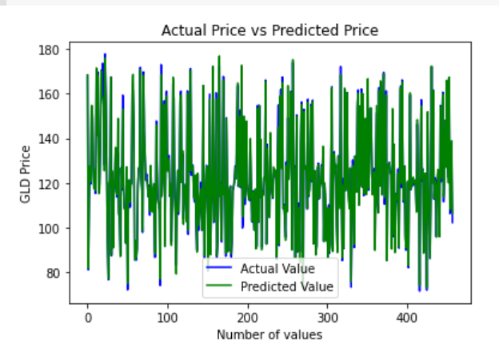
Sample Snapshot

Slide 15
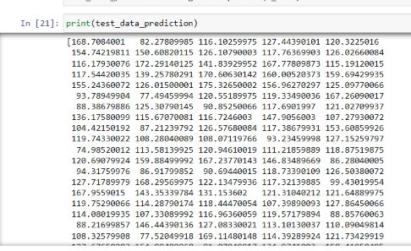
Results and Discussion
By seeing the above fig plotting values of actual prices, versus the predicted prices to know, how close our predictions were to the actual prices . we can observe, that the actual prices and the predicted prices are almost the same, as the two graphs overlap each other. Thus, or model has performed extremely well.
The predicted results of the data which was sent for testing is as follows:

Slide 16
Conclusion
The main aim of this study is to predict the gold price that is influenced by the economic variables such as stock
profit exchange, silver price, EUR/USD. In this study, we used the machine learning algorithms such as random forest to
predict the price of gold accurately. Considering the results obtained, we conclude that the random forest model performed
better than the other models.
For future work, we can improve the results and predict the price more accurately by incorporating the other factors such as gold production, crude oil price, platinum price,inflation to the data and by using deep learning. As you saw in this project, we first train a machine learning model, then use the trained model for prediction. Similarly, any model can be made much more precise, by feeding a very large dataset, to get a very accurate score

Slide 17
References
[1] V. K. F. B. Rebecca Davis, "Modeling and Forecasting of Gold Prices on Financia Markets," American International
Journal of Contemporary Research, 2014.
[2] Iftikharul Sami and Khurum Nazir Junejo, "Predicting Future Gold Rates using Machine Learning Approach",
International Journal of Advanced Computer Science and Applications, 2017.
[3] D Makala and Z Li, “Prediction of gold price with ARIMA and SVM”, Journal of Physics: Conference Series, 2021.
[4] Navin, Dr. G. Vadivu, "Big Data Analytics for Gold Price Forecasting Based on Decision Tree Algorithm and Support
Vector Regression (SVR)", International Journal of Science and Research (IJSR), 2013.
[5] P. V. M. Vasava, P. G. M. Poddar, Sima P Patel, "Gold Market Analyzer using Selection based Algorithm",
International Journal of Advanced Engineering Research and Science (IJAERS), 2016.
[6] Megan Potoski,”Predicting Gold prices”, CS229, Autumn 2013.
[7] Dr. Abhay Kumar Agarwal, Swati Kumari, "Gold Price Prediction using Machine Learning", International Journal of
Trend in Scientific Research and Development (ijtsrd), 2020.

Slide 18
THANK YOU

